Slide 1
Expedia Hotel Recommendation
Team 10

Slide 2
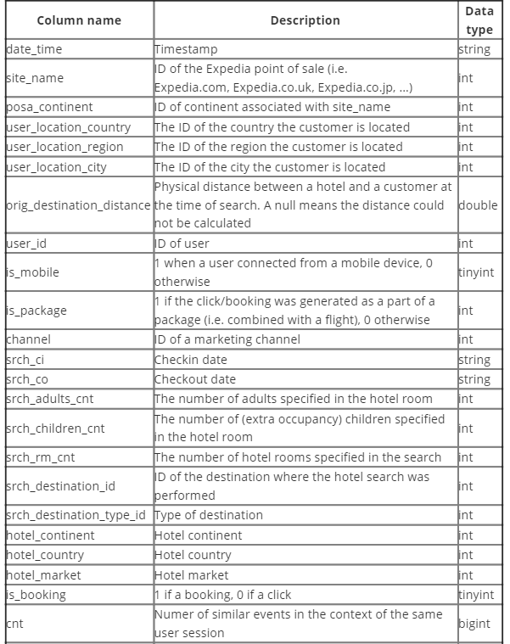
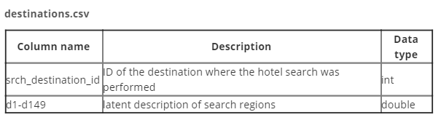
Background
Expedia uses search parameters to adjust their hotel recommendations, but there aren't enough customer specific data to personalize them for each user.
Goal:
Contextualize customer data
Predict the likelihood a user will stay at 100 different hotel groups.
Data description:
Logs of customer behavior (Train % Test)
Destination Information

Slide 3
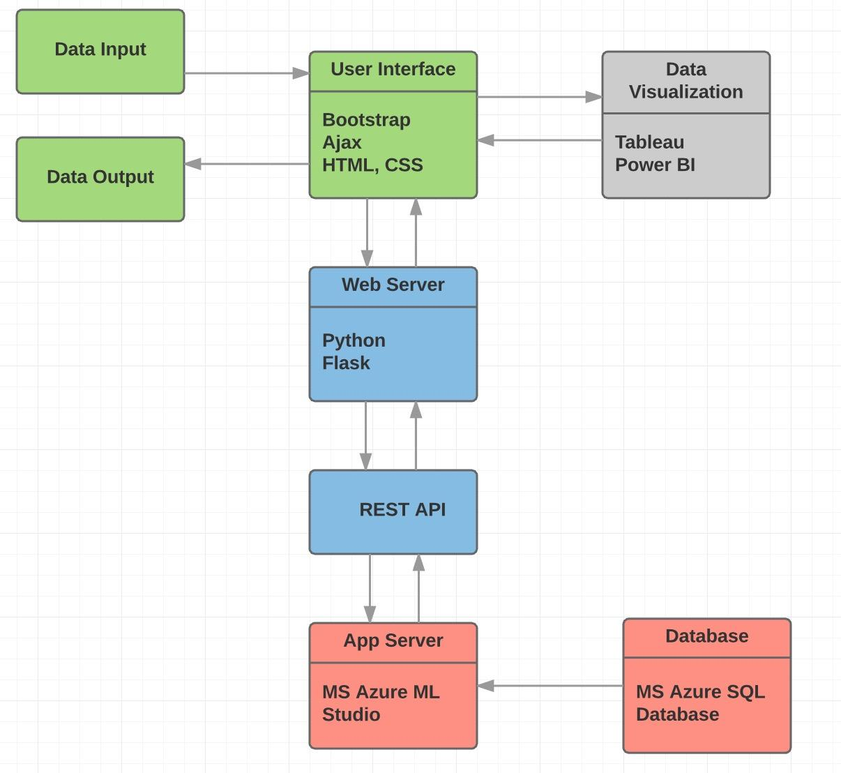
Project Plan
Data Exploration
Tool options: R, Python
Data Preparation
Tool options: R, Python, Alteryx
Data Visualization
Tools: Tableau, Power BI
Modeling
Tools: Microsoft Azure ML Studio, Alteryx, R, Python
Deployment
Tools: Python server, Flask framework, REST API

